Slide 1
5
Chapter Five
Advertising Management
Notes:
Advertising is still an important component of most integrated marketing communications plans. This chapter addresses issues involved in managing the advertising component of the IMC plan.

Slide 2
The Richards Group
5
Largest US independent agency
650 marketing professionals
$1 billion annual billings
Stan Richards
“We sell the truth”
Prefers hiring new college graduates
Co-mingle disciplines
Interdisciplinary villages
When hired – strategic process
Success stories
Chick-fil-A
Motel 6
Bridgestone – Super Bowl
The Home Depot
Notes:
The Richards Group is the largest independent advertising agency in the United States. It is located in Dallas, Texas, has 650 employees, and does about $1 billion in annual billings. Some of their larger clients include Chick-fil-A, Motel 6, Bridgestone, and The Home Depot. The company was founded by Stan Richards, who still maintains leadership of the company. When asked about his approach to the advertising business, he stated “We sell the truth.” Instead of placing similar staff together, he co-mingles disciplines. He believes it is very important to be next to someone that works in a different aspect of advertising. The company has “interdisciplinary villages” that are composed of creatives, account people, media people, research staff, and others. This allows for a team approach rather than a silo effect. When hired by a client, Richards states their first goal is to develop strategic plans with the client. Without strategy, advertising will not be effective.

Slide 3
Chapter Objectives
5
Advertising Management
What are the essential ingredients in advertising campaign management, including the role of advertising?
When should a company employee an external advertising agency rather than completing the work in-house?
How do companies choose advertising agencies?
What roles are played within advertising agencies and client companies?
Notes:
These are the objectives for Chapter 5.

Slide 4
Chapter Objectives
5
Advertising Management
What steps are completed as part of advertising campaign management?
What are the primary goals of advertising?
What are the key elements of an advertising budget?
What are the issues in the media-selection process?
How does a creative brief facilitate effective advertising?
Notes:
Additional objectives for Chapter 5.

Slide 5
Advertising Management
5
Chapter Overview
Advertising management
Choosing an advertising agency
Roles of advertising personnel
Advertising campaign management
Advertising research
Advertising goals
Advertising Budget
The Creative Brief
Notes:
This chapter presents an overview of managing the advertising function. The process of choosing an advertising agency is discussed. Then roles of various advertising personnel is presented. The last part of the chapter deals with managing an advertising campaign and includes topics such as advertising research, advertising goals, advertising budgets, and the creative brief.

Slide 6
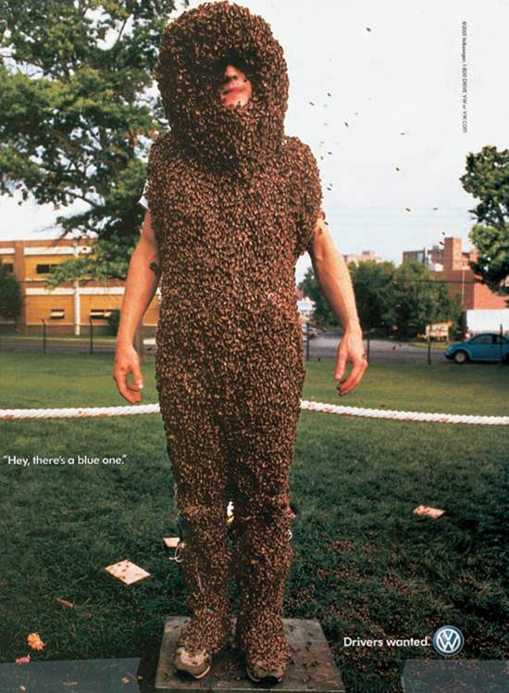
Advertising Terms
Message theme
Leverage point
Appeal
Executional framework
Notes:
The message theme is an outline of the key idea(s) the advertising campaign wants to convey to its audience. A leverage point is the key element in the advertising that taps into, or activates, a consumer’s personal value system. The appeal is the approach used to design the advertisement that attracts attention or presents information to the audience. The executional framework explains how the message will be delivered.

Slide 7
F I G U R E 5 . 2
Advertising Design Overview
Advertising Strategy
Chapter 5
Media Selection
Chapter 8
Advertising
Design
Message Strategy
Chapter 7
Executional Framework
Chapter 7
Appeals
Chapter 6
Notes:
This graphic presents an overview of the advertising design process. It begins with developing advertising strategy (Chapter 5). Then it proceeds to choosing an appropriate appeal (Chapter 6), an executional framework (Chapter 7), and the message strategy (Chapter 7). The last decision is the media selection (Chapter 8). But notice, the choice of media impacts the advertising design process.

Slide 8
Overview Advertising Management
Review role of advertising in IMC effort
Select in-house or external advertising agency
Develop advertising campaign management strategy
Complete creative brief
Notes:
Advertising management involves 4 steps. First, it is necessary to review the role of advertising in the IMC effort and how it relates to the other IMC components. It may be the lead role, or it could serve a support role. Second, select an advertising agency to design the advertising campaign, or use in-house creatives. Third, develop a strategy for managing the advertising campaign. Fourth, prepare a creative brief for the advertising agency to use in developing the campaign.

Slide 9
Advertising and IMC Process
Advertising still major component
Role of advertising varies
Business-to-business sector
Supporting role
Consumer sector
Primary communication vehicle
Notes:
Advertising is still a major component of integrated marketing. In terms of total marketing expenditures, advertising represents about 41% of the total. But, the role of advertising varies. In consumer marketing, advertising tends to be an important component. In business-to-business markets, it often serves the supporting role. There will also be variance within major sectors. For instance, some consumer product companies will place a greater emphasis on other forms of marketing and use very little advertising. For others, it may be just the opposite.

Slide 10
F I G U R E 5 . 4
Advantages of In-House versus Outside Agency
Advantages of In-House
Advantages of Outside Agency
Lower costs
Consistent brand message
Better understanding of product and mission
Faster ad production
Works closer with CEO
Lower turnover rate in the creative team
Reduce costs
Greater expertise
Outsider’s perspective
Access to top talent
Source: Adapted from Rupal Parekh, “Thinking of Pulling a CareerBuilder? Pros and Cons of Bringing an Account In-House,” Advertising Age, http://adage.com/print?article_id136701, May 18, 2009
Notes:
Companies have to decide whether they will do the advertising work in-house or obtain an outside advertising agency. Each has advantages. With an in-house staff, normally costs are lower. It is easier to ensure a consistent brand message across campaigns and across various products within the company. In-house staff has a better understanding of the product and the mission of the company. They usually will work closer with the CEO. With in-house, from creative to production is normally faster since the company has direct control of the employees. There is also a lower turnover in the creative team, which provides greater consistency across campaigns. Outside agencies offer some advantages. Costs may be lower if the in-house team lacks the expertise and a lot of time and effort is wasted in doing the work. Outside agencies have greater expertise and an outsider’s perspective. Both can be extremely valuable in generating fresh ideas and creating effective campaigns. With agencies, firms may have access to some of the top talent. While it may cost more to use an agency, the superior work produced is normally worth the price.

Slide 11
Budget Allocation Considerations In-House vs. Advertising Agency
Size of account should match size of agency
75-15-10 Rule
75% - Media buys
15% - Creative work (agency)
10% - Ad production
Notes:
Costs are a major consideration in selecting an outside agency. The size of the account should match the size of the agency. Smaller accounts may be lost with a large agency and a large account would overwhelm a small agency. The 75-15-10 is a good guide to use. When looking at the total cost of an advertising campaign, 75% of the money should be spent on media buys, 15% on creative work by the agency, and 10% on production of the ads.

Slide 12
Crowd Sourcing In-House vs. Advertising Agency
New alternative
Outsource creative
Doritos
Harley Davidson
Overall cost not lower
Advantages
Consumers involved
Generate buzz
Notes:
Crowdsourcing is a recent alternative to choosing an advertising agency. Crowdsourcing involves seeking ideas from the public and even videos of ad productions. Two companies that have successfully used crowdsourcing are Harley Davidson and Doritos. Unilever used it for their meat snack product, Peparami. Doritos has used in the Super Bowl. While it would appear the costs would be much lower, it is not. Most crowdsourcing involves a contest and a Web site. Then the entries have to be judged, and in most cases the ad is professionally produced once the idea has been selected. But, the advantages of crowdsourcing is that it gets consumers involved and it often will generate buzz among individuals as the entries are posted and passed along to other people.

Slide 13
External Advertising Agencies
Boutique
Full-Service
Advertising agencies
Media service companies
Direct marketing agencies
Consumer and trade promotion specialists
Online and digital agencies
Social media agencies
Public relations agencies
Notes:
Advertising agencies come in all sizes and shapes. They range from boutiques that offer only one type of service or serve one type of client to full-service agencies that offer the full spectrum of services. Advertising agencies will often provide other marketing services. Media services companies provide media planning and media buying services. Direct marketing agencies work with all types of direct response marketing campaigns. Some agencies specialize in consumer or trade promotions, or even focus on a specific type of promotion, such as couponing. Public relations firms handle both positive and negative publicity events. A growing number of agencies handle only online or social media.
A recent phenomenon that has occurred is the whole-egg theory, first mentioned by Young & Rubicam Agency. The idea of the whole-egg is that an advertising agency should provide full marketing services for a company and assist in integrating every aspect of the company’s marketing effort.

Slide 14
F I G U R E 5 . 6
Steps in Selecting an Advertising Agency
Set goals
Select process and criteria
Screen initial list of applicants
Reduce list to two or three viable agencies
Request creative pitch
Notes:
Choosing an agency requires time and effort. While companies can shortcut the process, such an approach often results in the best agency not being hired. The first step is to select goals. Then the company should decide on a process and criteria before contacting any agencies. Once proposals have been received, the list can be narrowed down to 2 or 3 viable agencies. A creative pitch is then requested from each of the agencies to determine the best choice.

Slide 15
Choosing an Agency
Goal Setting
Set before contacting agencies
Provides direction
Reduces biases
Notes:
Goal setting should occur before contacting any agencies. Doing so will prevent any biases towards a particular agency. Also, the goals provide direction. It will help the company understand what it wants from an agency and where the company wants to go.

Slide 16
F I G U R E 5 . 7
Evaluation Criteria in Choosing an Ad Agency
Size of the agency
Relevant experience of the agency
Conflicts of interest
Creative reputation and capabilities
Production capabilities
Media purchasing capabilities
Other services available
Client retention rates
Personal chemistry
Notes:
The second step in the process is setting the evaluation criteria. Again, this should be done prior to talking to any agencies. As has already been discussed, size of the agency is important. The agency should have experience in the industry, but not be representing a direct competitor. This would be a conflict of interest. Creative reputation and capabilities should be considered since the primary role of the agency is to generate creative ideas. The product and media purchasing capabilities are not essential. Some agencies do this, others use subsidiaries or contract it out to boutique shops. Client retention rates may be important, but with the turnover among agencies today, it is has lost a lot of importance. Personal chemistry is important because individuals from the two companies must work together and generate ideas that will move the brand forward and accomplish objectives that have been set.

Slide 17
Creative Pitch
2 to 3 finalists
Formal presentation → shootout
Specific problem/situation
Expensive for agencies
Notes:
Once the list has been narrowed down to 2 or 3, it is time to ask for a creative pitch (or shootout). Agencies are given a specific problem to address. Creative pitches are expensive for agencies, so companies need to be serious about an agency if it requests a pitch. From the creative pitches, the company should select the agency that offers the best plan.

Slide 18
Key Advertising Personnel
Client
Marketing Manager
Client
Marketing Manager
Client
Marketing Manager
Account
Executive
Account
Planner
Creative
Director
Traffic
Manager
Media
Buyers
&
Planners
Creative
Creative
Creative
Creative
Notes:
In the advertising agency, there are some key individuals. The account executive is the liaison between the company and the agency. They are to represent the client within the agency. Account planners are the voice of the consumer and assist in overall planning and strategic direction of the campaign. Their role is to see the total picture. The creative director is responsible for the creative aspect of the campaign and works with the agency’s creative staff. The traffic manager’s role is to manage the campaign scheduling to ensure the campaign is finished on time. With multiple components, as was in the Oscar Mayer campaign, it means juggling numerous deadlines and people’s schedules. Media buyers and planners are involved in the selection and purchase of media.

Slide 19
Role of Quality Communications
Survey of senior executives
30% of staff’s time wasted
75% of agencies go through significant changes in direction
Agencies deal with multiple people
Clients want good value, results
Stewardship reports
Notes:
Quality communications between the client and advertising agency is critically important. A survey of senior executives at marketing and advertising agencies indicated good communication is not always present. The survey found that about 30% of the staff’s time was wasted or used ineffectively due to poor communications. About 75% of the agencies went through significant changes in direction with clients. Agencies often deal with multiple people, and it is not unusual that each person wants something different, or to even go in a different direction. Clients want good value and results from advertising agencies, but often don’t spend quality time with agencies to ensure it happens. One way agencies can assist in the process is through periodic stewardship reports.

Slide 20
Advertising Campaign Management
Conduct and review advertising research
Establish advertising objectives
Review advertising budget
Select media
Prepare creative brief
Notes:
Advertising campaign management involves these five steps. It doesn’t matter if the work is done in-house or with an external agency, the same steps need to be followed to ensure a successful advertising campaign.

Slide 21
Advertising Research
Understand customers
Purchase benefits, not attributes
Product-specific research
Key selling points
Desirable features
Consumer-oriented research
Context of product use
Anthropological approach
Sociological analysis
Psychological motives
Focus groups
Notes:
The first step in advertising management is conducting research. If an advertising agency is used, then it is the responsibility of the agency to conduct this research so they understand the customer. What are the key benefits customers derive from the product? Consumers buy benefits, not attributes, so it is important to think in those terms, i.e. what does this product do for customers, how does it help them? Product-specific research involves identifying the key selling points of a product and the desirable features. To develop an advertising campaign, the creative staff should understand the product. Customer-oriented research focuses on the users of the product and how, when, and why the product is used. Researchers can use approaches based in anthropology, sociology, and psychology. A common method used by agencies for customer-oriented research is the focus group.

Slide 22
Motel 6 and The Richards Group
Motel 6 client for 24 years
Insight through qualitative research
Focus group – Account planner
Round 1 – no Motel 6
Round 2 – no Motel 6
Finally, Motel 6 mentioned
Save money
Benefit of frugality
No difference once light is out
Notes:
The Richards Group used focus groups to help them understand users of Motel 6 and hotel users in general. These focus groups took place when The Richards Group first landed the contract with Motel 6, 24 years ago. Insights from these original focus groups led to the campaign theme and approach used. The focus groups were conducted by the agency’s account planner. He asked the members of the focus group where they stay when they are on the road. The agency knew everyone in the focus group had stayed at a Motel 6, but in the first round Motel 6 was not mentioned. Same for the second round. Finally, someone said they stay at Motel 6. Then others admitted they do also. As they talk further, pride in saving money comes out. It becomes evident that one of the benefits of Motel 6 is frugality, saving money. Then someone comments “when the lights are out, it doesn’t matter anymore which one it is.”

Slide 23
F I G U R E 5 . 9
Advertising Goals
To build brand image
To inform
To persuade
To support other marketing efforts
To encourage action
Notes:
The second step in advertising management is to set objectives. Advertising objectives include building brand image, informing consumers, persuading them about a brand, supporting other marketing efforts like couponing or a contest, and encouraging action.

Slide 24
Build Brand Awareness Advertising Goals
Brand image begins with awareness
Consumers recognize brand
Business-to-business
Especially important in modified rebuy situations
Successful brands possess
Top-of-mind
Top choice
Brand equity leads to top-of-mind & top choice
Notes:
A primary goal of advertising is to build brand image, to enhance a brand’s equity with consumers. The process begins with brand awareness. If consumers are not aware of a brand, then brand image advertising can’t succeed. Brand awareness and brand image is especially important in modified rebuy situations because companies may not always seek every qualified bidder. Successful brands possess two characteristics. Top-of-mind are the brands a consumer mentions first when asked about brands in a particular product category. Top choice is the brand within a product category that consumers prefer the most. To be top choice requires top-of-mind. Brand equity leads to top-of-mind and top choice.

Slide 25
Provide Information Advertising Goals
Notes:
This advertisement by GameStop provides information to customers that when they get stumped with a game contact the employees of GameStop. Not only do they work for GameStop, they also play the games.

Slide 26
Persuasion Advertising Goals
Notes:
A common goal of advertising is to persuade consumers that a particular brand is superior to others and should be that top choice. This ad for Flair Jewelers says “Nobody Does ‘I Do’ Like We Do.”

Slide 27
Support Marketing Efforts Advertising Goals
Consumer promotions
Retailers
Special sales
Promotional campaign
Notes:
Advertising is often used to support other marketing efforts. It can be used as the framework for a consumer promotion, such as for this coupon offer for Del Monte. It can be used by retailers in newspaper ads to support special sales or products that are marked down. When ads are combined with other marketing efforts into a larger, more integrated effort revolving around a promotional theme, the program is called a promotional campaign.

Slide 28
Encouraging Action Advertising Goals
Behavioral goals
Encourage some type of action
Inquiry
Access Web site
Visit retail outlet
Send e-mail or telephone
Business-to-business
Notes:
Advertising can be used to encourage action of some type. The action does not necessarily have to be to make a purchase. It can encourage consumers (or businesses) to make an inquiry, to access a Web site for further information, to visit a retail outlet, or to send an e-mail or make a telephone call. The goal is to encourage the individual to do something rather than passively observe the ad. Call-to-action advertising is used often in business-to-business advertising to solicit inquiries from other businesses.

Slide 29
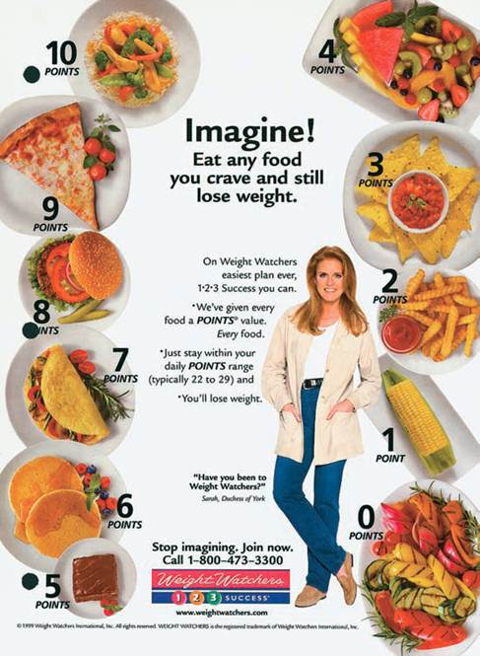
The Advertising Budget Manner of Distribution
Pulsating schedule
Bursts of intensity
Flighting schedule
Spending at select times
Continuous schedule
Keep brand before consumers
Notes:
The third step in the advertising management process is a review of the advertising budget. Normally, the dollar amount of the budget has already been set in the IMC planning process discussed in Chapter 4. In advertising management the decision is on how to administer or distribute that budget. There are three basic ways to do it. Pulsating schedules involve continuous advertising during the entire year with bursts of higher intensity at specific times, such as during the Christmas season, or summer, or during certain holidays. Flighting schedules involve spending money at just certain times of the year with no advertising at other times. This approach works well for seasonal products, such as lawn mowers and snow removal equipment. Continuous schedules keep the brand before consumers all year by spreading the advertising dollars throughout the year in a relatively even amount.

Slide 30
Media Selection
Media-usage habits of target market
Audience characteristics of media
Business-to-business media
Earlier involvement of media companies
Notes:
One of the challenging tasks of advertising management is to pick the media that will be used. More information about this process will be presented in Chapters 8 and 9. But, at this point, it is important to realize that to pick the right combination of media requires understanding the media habits of the target market then matching that with the audience characteristics of each media. This process is used in business-to-business media as well as in consumer media. Because of the importance of placing ads in the right media, companies are now involving media companies at an earlier stage of the ad development process rather than after the campaign has already been completed.

Slide 31
F I G U R E 5. 10
The Creative Brief
The objective
The target audience
The message theme
The support
The constraints
Notes:
The last step in advertising management is the writing of a creative brief. The appearance of creative briefs will vary among advertising agencies and clients, but most contain these five elements: the objective of the campaign, the target audience, the message theme, any support that can be used, and any constraints. The creative brief is prepared by the client, often with the help of the account executive or account planner from the agency. It is a document used by the creative team at the agency to prepare the advertising campaign so it needs to be clear and provide enough information so that the creative team understands what the client wants.

Slide 32
The Objective
An advertisement for Sub-Zero designed to enhance the brand’s image.
Notes:
The first component of the creative brief should be to state the objective of the campaign. Designing campaigns aimed at increasing brand awareness will look different from campaigns designed to build brand image, to encourage immediate action, or to stimulate sales. The objective for this advertisement for Sub-Zero was to enhance the brand’s image. The target market was business buyers of industrial refrigerators in food service industries, such as restaurants and cafeterias at hospitals and universities.

Slide 33
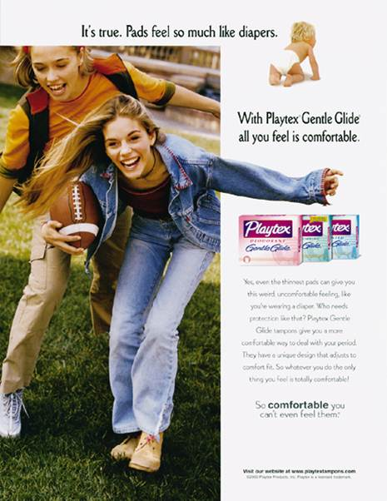
The Target Audience
The target market for this ad is females, 13-30, who enjoy sports and have an active life style.
Notes:
Information about the target audience is critical. Creatives need more information than just demographics. Telling them to create an ad for Playtex and the target audience is females 13 to 30 is not sufficient. Psychographic information provides richness about the target audience that can be used by the creative team. For this product, the target audience were females who enjoyed sports and lead an active life style. The more information that is provided, the better the creative team understands the target market.

Slide 34
The Message Theme
The message theme of this milk advertisement was that milk will provide calcium. The calcium will provide the customer with benefit of strong bones.
Notes:
The creative brief needs to contain the primary message theme the client wants to convey to its target market. The message theme in this series of ads for milk was that milk provides women with calcium, which produces stronger bones, which leads to a healthier life.

Slide 35
The Message Theme
Unique selling point
“Left brain” advertisement
Logical, rational side of brain
Manages numbers, letters, words, concepts
Use rational appeal
“Right-brain” advertisement
Emotional side of brain
Manages abstract ideas, images, feelings
Use emotional appeal
Notes:
The message theme should be the one (not multiple) unique selling point the client wants its target audience to get. When thinking about message themes, it helps to think about the difference between left brain messages and right brain messages. The left side of the brain is logical and it is where people manage numbers, letters, words, and concepts. Left brain advertising focuses on rational appeals that require thought, the cognitive component of attitude. The right side of the brain is where the emotions lie and it manages abstract ideas, images, and feelings. So right brain advertising should use an emotional appeal, the affective component of attitude.

Slide 36
The Support
The support claims in this ad MicroThins are:
30% thinner
40% lighter
4 times more scratch resistant
10 times more impact resistant
99.9% UV protection
Anti-reflective
Notes:
Ads will often provide support for their product. It is the responsibility of the client to provide any support that might be used in an advertising campaign. If an automobile was designated as Motor Trends car of the year, that is valuable support that can be included to support brand image advertising. In this ad for Pearle Vision, a number of support items were provided about MicroThins. They are 30% thinner, 40% lighter, 4 times more scratch resistant, 10 times more impact resistant, provide 99.9% UV protection, and are anti-reflective.

Slide 37
The Constraints
Legal and mandatory restrictions
Constraints
Disclaimers
Notes:
Constraints are things advertising can’t say or do, or things that must be included in ads. For some products, there are legal and mandatory restrictions that must be included. For drugs, companies must tell consumers about all of the possible side effects. For tobacco products there must be a warning from the Surgeon General. Companies may have other constraints, such as the logo must appear in all ads, or the logo must be in a specific color or shape. Disclaimers may also be included in ads, or warranty statements. Most of the constraints are either legal requirements or company-imposed requirements to protect from lawsuits.

Slide 38
Del Monte Advertisement
What is the Creative Brief?
The objective
The target audience
The message theme
The support
The constraints
Notes:
The answers to these questions are provided in the next slide.

Slide 39
Creative Brief Del Monte
The Objective – increase awareness of the smaller-size cans with pull-top lid
Target Audience – senior citizens, especially those who live alone and suffer from arthritis
Message Theme – the new cans contain a smaller portion and are easier to open
Support – 30 cent introductory coupon to encourage usage
Constraints – copyright logo, toll free number, Web site address, legal requirements of a coupon, and what is meant by a small serving
Notes:
The target audience may also be females who enjoy cooking since the visual was of a dish that could be prepared using Del Monte products.

Slide 40
International Implications
62% of advertising budgets spent outside of U.S.
Two major differences
Process of agency selection
Preparation of international advertising campaigns
Preplanning research varies
Understanding of languages and cultures
Media selection varies
Notes:
Approximately 62% of advertising budgets are spent outside of the United States. The two major differences are the process of selecting an agency and the preparation needed for an international advertising campaign. Preplanning will also vary across countries. When developing global ad campaigns, you have to pay close attention to language and culture differences. Translating to another language is not sufficient. Media selection also varies in other countries. The mix that is used in the U.S. is not the same as it would be in Japan, Peru, Spain, or Germany.

Slide 41
F I G U R E 5. 11
Non-U.S. Ad Budgets and Sales Revenues for Major Corporations
Source: Adapted from Laurel Wentz and Bradley Johnson, “Top 100 Global Advertisers Heap Their Spending Abroad,” Advertising Age, http://adage.com/print?article_id=140723, November 30, 2009.
Notes:
This graph illustrates non-US ad budgets to sales revenue for some major corporations. For instance, 83.5% of Coca-Cola’s advertising budget is spent outside of the United States and 74.9% of the company’s income is generated outside the US. For Colgate-Palmolive, 85.6% of the ad budget is outside of the US and 76.7% of revenue is generated outside of the US.

Slide 42
Ouachita Independent Bank (Part 5)
ClowBaack – Integrated Campaigns in Action
Selection of Advertising Agency
Newcomer Morris and Young
Local agency
Size matches with firm
Relevant experience with financial institutions
No conflict of interest
Creative reputation – winning of awards
Capability to product multi-media advertisements
Good chemistry
Notes:
In selecting Newcomer, Morris, and Young advertising agency, the Ouachita Independent Bank followed the steps outlined in the text. It is a local agency and one of the larger agencies in the area which fits well with the size of the bank. They have experience with financial institutions but not representing a competitor at this time. The agency has won numerous awards for their creative ability. The have the capability of handling multi-media, including print, digital, and broadcast ad production. Lastly, there is good chemistry between the agency and the bank. The agency’s website can be accessed to show how NMY is a good fit with OIB.

Slide 43
Ouachita Independent Bank (Part 5)
ClowBaack – Integrated Campaigns in Action
Advertising Goal
Newcomer Morris and Young
To persuade
Notes:
The goal of the advertising campaign is to persuade consumers and local businesses to consider OIB for their banking and financial needs. This TV ad can be played and discuss with the students how this ad supports the advertising goal.

Slide 44
Ouachita Independent Bank (Part 5)
ClowBaack – Integrated Campaigns in Action
Creative Brief
Newcomer Morris and Young
The Objective – to persuade
Target Audience – Thinkers, achievers, believers (VALS2)
Message Theme – local bank, local trust
Support – local bank with secure history and strong financial position.
Constraints – FDIC logo and insurance statement, OIB logo, and website URL on all ads.
Notes:
The creative brief used to develop the campaign is provided.

Slide 45
Integrated Campaigns in Action
Progressive
Bank
Notes:
The Progressive Bank campaign was prepared by French Creative Advertising Agency. The campaign features various print components. Magazine, newspaper, outdoor, and mall kiosk media were used in the campaign. The objective of the campaign was to highlight the bank’s involvement in the local community.

